Slide 1
Image and Video Processing Assessment
Student Presentation
By Ellie Pitt 07/01/2024

Slide 2
Task Selection
Image
Level 4
Video
Level 4
This task was Image Convolution which is a an operation in image processing that applies effects and filters onto images. It does this by combining the pixel values of the image with an image kernal function. This will enhance certain features on the image.
This video task was object tracking where a box will locate and follow a specific object or person or several within a sequence of frames in a video. It has functions that can track the object position overtime maintaining the tracking throughout all the video frames.

Slide 3
Academic Background
Image convolution
Object Tracking
Convolution is explained as a formal mathematical operation that wakes two signals and produces a third signal.
Its used in mathematics of many fields like statistics and probability.
In linear systems its used to describe the relationship between three different signals of interest being the input signal, the impulse response and the output signal.
In the mid 20th century convolution was widespread in digital signal processing and contributed to advancements in audio and image processing.
Convolution became a main component in computer vision algorithms especially in image filtering tasks.
Object tracking goes all the way back into the mid 20th century in computer vision research.
Algorithms such as Kanade Lucas Tomasi feature the tracker in the 1980s which laid down the foundations for object tracking.
The application of Kalman's filters in the 1960s had crucial development for object tracking.
Theoretical background includes how object tracking evolved with machine learning and deep learning techniques.
Understanding Kalman's filters provides insights into the modelling and predictions of object tracking and has challenges and solutions for handling multiple objects in tracking.
References:
www.dspguide.com. (n.d.). The Scientist and Engineer’s Guide to Digital Signal Processing’s Table of Content. [online] Available at: https://www.dspguide.com/pdfbook.htm.
‌

Slide 4
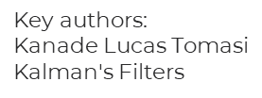
Real Life Applications
Image convolution
Object Tracking
Image convolution is used in medical imaging such as x ray enhancement to enhance the details of x ray machine images that help aid diagnosis in the medical field. Also, MRI imaging that applies noise reduction and feature extraction in MRI.
Its used in computer vision such as facial recognition where Convolutional neural networks use convolution for feature extraction in facial recognition systems. Furthermore, object detection where convolutional techniques are essential in identifying objects within different images or frames within videos.
Object tracking is used in surveillance systems such as security cameras as it enhances surveillance by simultaneously monitoring and following moving objects within the cameras view.
Also, its present in automated vehicles where self-driving cars use object tracking aids to identify and track other vehicles nearby, people and obstacles for safe navigation.
In augmented reality (AR) it is used in gaming and entertainment industry where object tracking is used for interacting with virtual objects in real time by making the entertainment and gaming experiences better for the user.

Slide 5
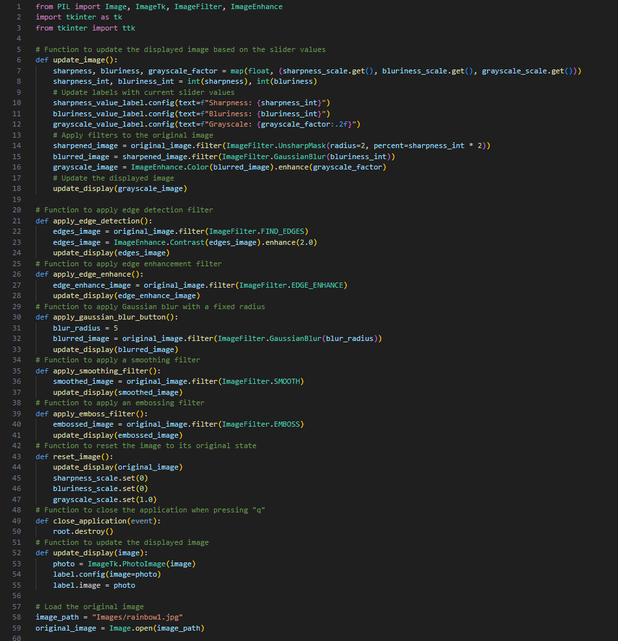
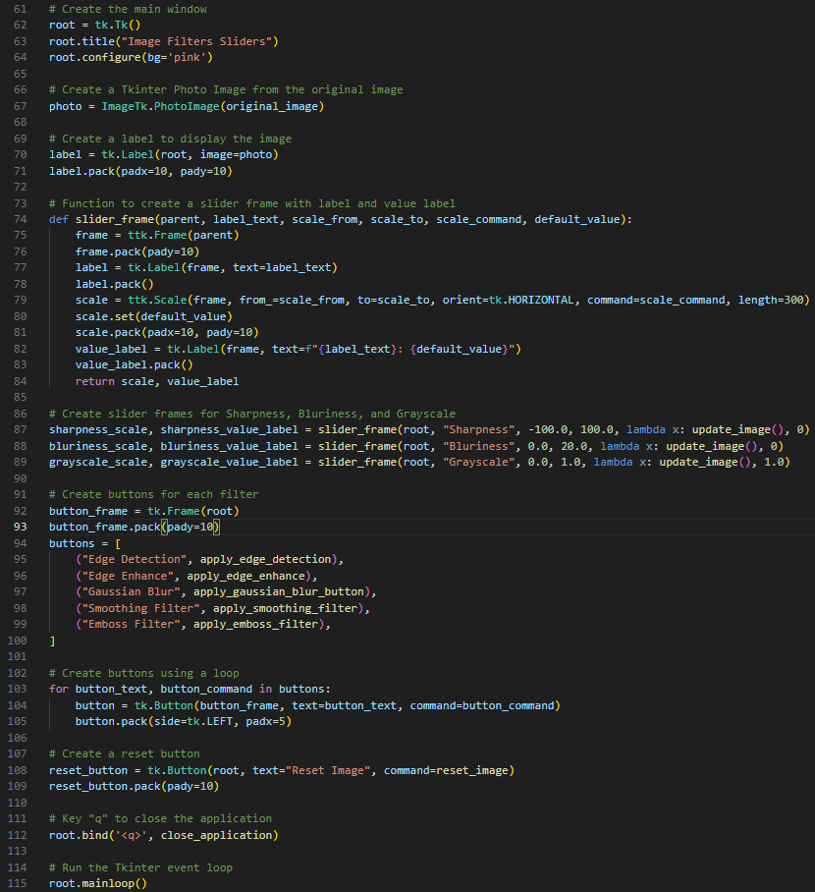
Python Code Showcase – Image Code

Slide 6
Image Code Explained
For my Image I have used the Tkinter library to create a GUI for my level 4 image convolution task. The GUI has sliders that adjust the sharpness, blurriness and the grayscale levels of the image and functions like the update image function will apply these three filters onto the loaded image and can be used to affect the image simultaneously.
Also, the code has buttons for other specific filters such as: edge detection, edge enhancing, gaussian blur, smoothing and embossing. Furthermore, there is a reset button and the ability to close the application by clicking the letter “q” or clicking x in the top right corner. There is a pink background on the application too that boosts the aesthetic look of the application.
The application I have create will in summary allow the user to interact with the image by using scrollers or buttons to explore different image filters.

Slide 7
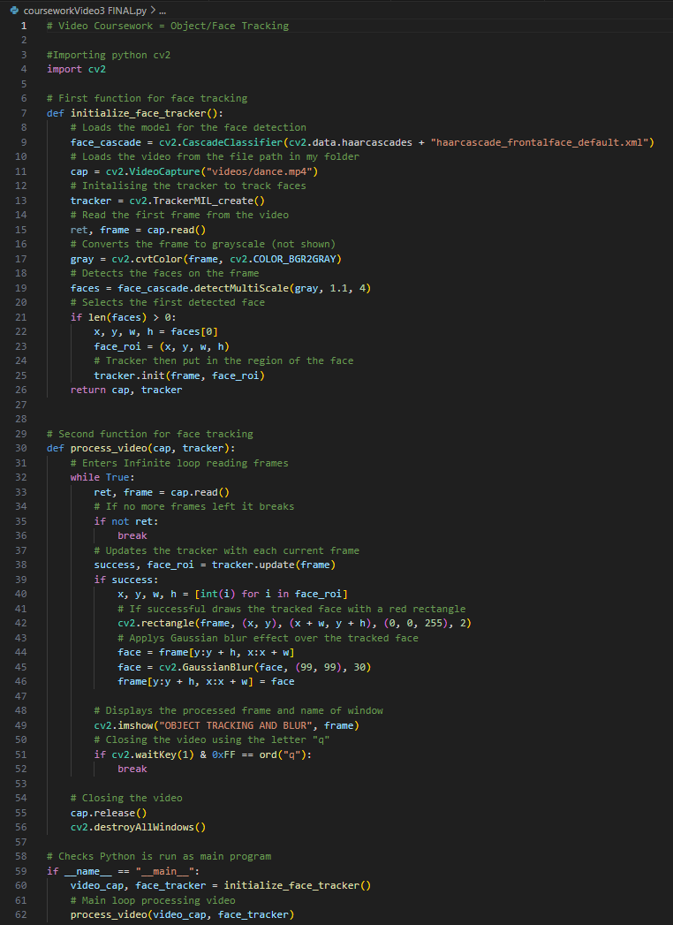
Video Code Explained
For my video I have coded object tracking with a red box and a blur effect over the face of the person within the video.
The code uses the Open CV library to perform face detection, image processing and object tracking within a video. It has a Haar Cascade model to detect the faces and the MIL tracker for the object tracking.
Within the coding loop the program continuously reads each frame of the video, updates the MIL tracker and if this is working correctly it will apply a red rectangle around the tracked face in the video and apply a Gaussian blur. This will be displayed until the end of the video, or the video is closed using the letter “q”.

Slide 8
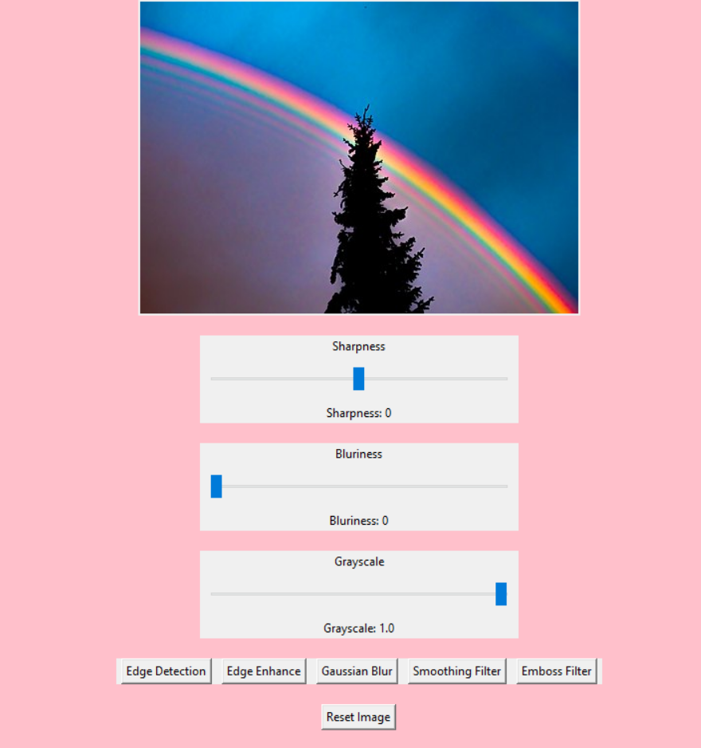
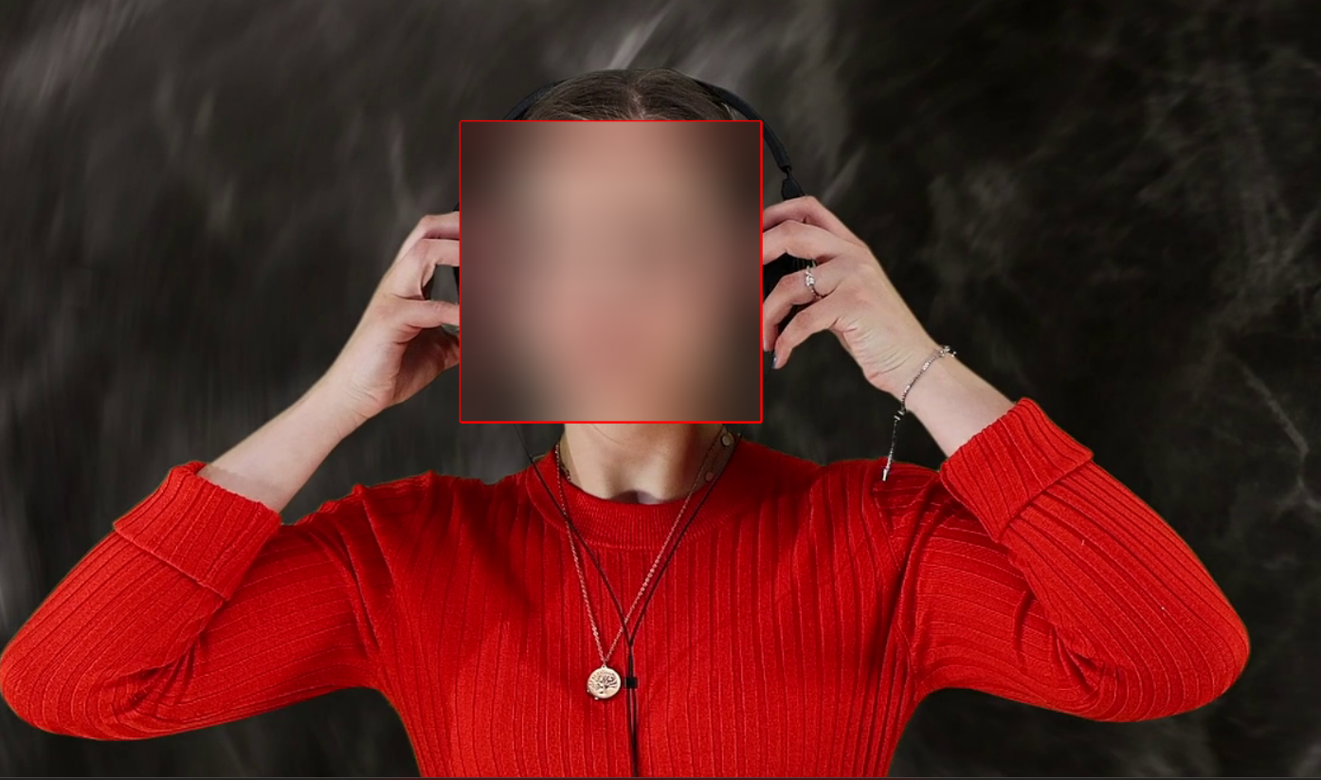
Demonstration and Results
This is the application my image code has created, the image at the top is the image that can be changed with the different filters. There are three scrollers displayed that are interactive and will change the appearance of the image while moving the scrollers.
There are five buttons that add a filter onto the image and a reset button to reset the image back to its original form.
This is my video where the code has added a red box around the persons face that tracks them each frame throughout the video while moving. There is also a gaussian blur that’s covering the persons face and that is also tracked each frame and moves with the person to keep anonymity throughout.

Slide 9
Parameter Exploration
Image convolution
The “update_image” function includes “sharpness_scale”, “bluriness_scale” and “grayscale_scale” sliders that control the sharpness, blurriness and the grayscale of the image. Also has parameters for the unsharp mask filter where the radius is equal to two and the percent is equal to the sharpness int times two. The fixed radius for the Gaussian blur filter is equal to five.
Filter functions such as “apply_edge_detection” and “apply_edge_enhance” use predefined filters from the image filter module. Some of the functions like “apply_gaussian_blur_button” use fixed parameters such as “blur_radius”.
The “reset_image” function resets the sliders to their default values zero and the grayscale to one so its set as colour as default and removes the filters added by the buttons.
The “slider_frame” function that has “scale_from” and “scale_to” are the minimum and maximum values for the slider. This is useful when comparing the processed images to their original form.
The slider frames such as “sharpness_scale”, “bluriness_scale” and “grayscale_scale” are parameters like length, range and orientation are set using the “slider_frame” function. These allow interactive and adjustable parameters that move the sliders along to their corresponding values.

Slide 10
Parameter Exploration
Object Tracking
The face detection model has “face_cascade = cv2.CascadeClassifier…..” which initializes the haar cascade classifier for face detection and the file contains pre trained data for detecting people's faces.
The video capture has “cap=cv2.videocapture(file)” which initializes the video capture object using the video file that has been put into the code that plays the video.
Face detection and tracking initialization has “faces=face_cascade.detectmultiscale” to detect faces within the first frame of the video using the haar cascade classifier. If the faces are detected within the first frame the first faces coordinates are used to first initialize the object tracker.
The gaussian blue parameters that cover the persons face with a blur uses the code “face = cv2.gaussianblur(face, (number))” to apply the bur to the tracked face region and the parameters used in this case (99,99) is the size of the kernel and (30) is the standard deviation used.
Displaying the processed frame is showed by “cv2.imshow(“OBJECT RACKING AND BLUR”, frame) which displayed the processed frame in a window with the title displayed.
The video release and window destruction is written in “cap.release()” that releases the video capture object and “cv2.destoryAllWindows()” which closes all the windows.

Slide 11
Problems and Limitations
Within my image convolution I had a problem with a few errors as it took me a few times to perfect my code and get it to work with my image such as getting the scrollers to apply the filter while simultaneously moving the scroller along. This was corrected through research where I learned how to fix this issue.
In my object tracking I had trouble choosing the right tracker as I had to pick it based on the specific requirements and characteristics that could track the persons face properly so in the end, I chose the MIL tracker as it tracked the persons face the most accurately and was the simplest tracker to use.
Some limitations of the image convolution code would be there are only eight different filters you can apply to the image whereas there could be more added to extend the range of filters applied to the image. I could also add in the code where the user can choose their own image from their files, they would like to use instead of a pre-set image.
The video I would have liked to have made the video play faster as it currently plays at a slower rate and add some more interactive features for the user such as the ability for them to add and remove the face tracking and gaussian blur when they choose.

Slide 12
Conclusion
In conclusion, I created two different pieces of code, one for image convolution and one for object tracking on a video. For the image convolution I managed to add three filters using the scrollers to be able to change the filter added to the image, these scrollers can also affect the image at the same time. I had five filters added using buttons that applied filters onto the image Aswell and a reset button that reset the image to its original form. Additionally, I added a pink background to the application to make it more visually pleasing for the user.
For the object tracking I managed to get a video of a lady listening to music and I added a gaussian blur onto her face that was tracked whenever she moved each frame of the video and kept her anonymity. Furthermore, I added a box around her face that tracked her using the object tracker MIL and I managed to make this box appear red.
Things I can take away from this include having more and better coding skills for future projects that I will be able to use from this experience. Furthermore, I have learnt more knowledge on problem solving as coding is a structured and analytical approach to their and I learned how to break down issues I faced into smaller pieces and was able to fix them.

Slide 13
Questions & Answers
Thank you for listening! ☺

